Slide 1
Last two questions
on Eniacs A/B Testing

Slide 2
How can we ever be sure that the version with the best performance is not having more clicks due to just chance?
The science of statistics deals with probabilities, not absolute statements
We can never be absolutely sure
However we can define how sure we want to be
We want to reduce the probability that something is due to “just chance” below 5 %.

Slide 3
Using the Chi-Squared Test
The Chi Squared test returns the probability, that the outcome is by chance
A Chi Squared result of below 5% (or 0.05) is considered to be statistically significant.
That means we are 95% certain that the observed behavior is not by chance.

Slide 4
How many users do we need to be 95% sure?
We considered our A/B test to have 2 options: A) Baseline and B) Colour
Results | A / B Conversions | Chi² < 5% | # of Users
Ambiguous | 500 / 564 | 0.044 | 114,702
Very clear | 500 / 650 | 0.00000764 | 21,539

Slide 5
How long can we expect the experiment to last in general?
The experiment lasts until the sample size for a statistically significant result is reached.
If there are significant differences, the tests can be stopped early.
If we want to be sure about a large difference we need less samples.

Slide 6
How long can we expect the experiment to last?
We considered 2 options (baseline and colour)
** Beware that tests should run cyclical patterns (visible in the baseline), such as weeks.
Results | A / B Conversions | Chi² < 5% | # of Users | Duration
Ambiguous | 500 / 564 | 0.044 | 114,702 | est. 3 weeks
Very clear | 500 / 650 | 0.00000764 | 21,539 | 1 week**

Slide 7
Any further questions?

Slide 8
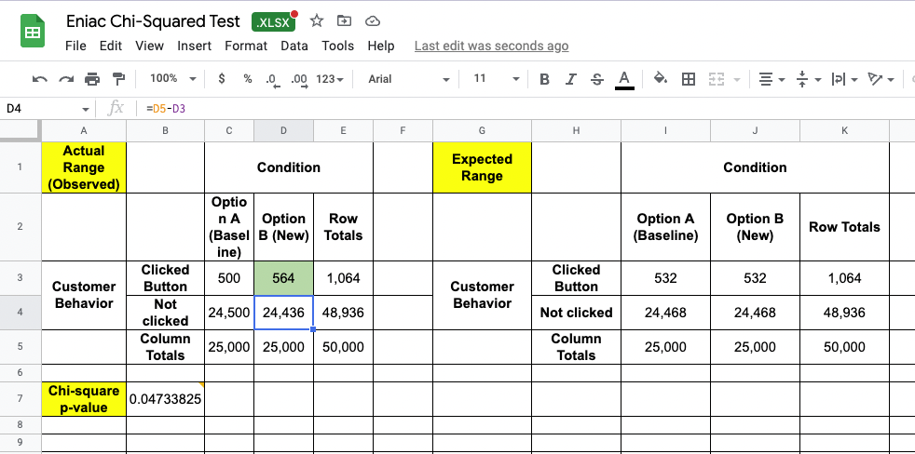
Minimal difference to be 95% sure

Slide 9
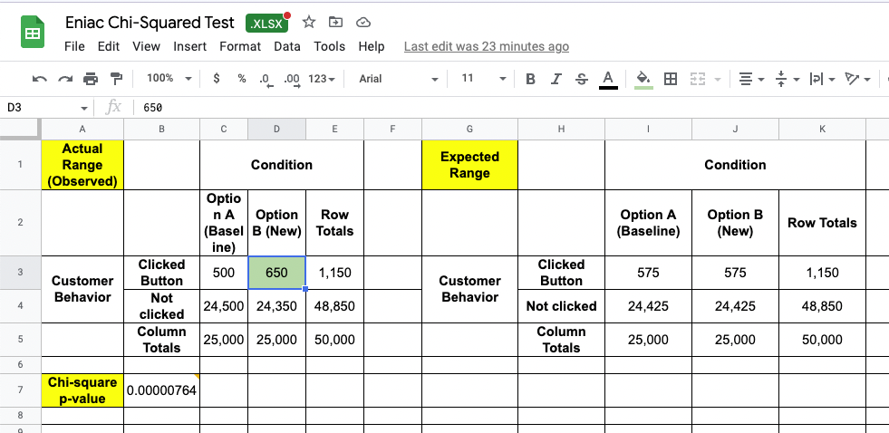
Significant difference 99.999% sure

Slide 10
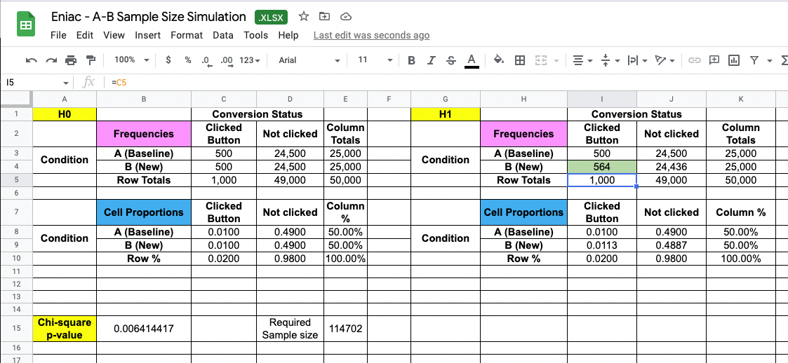
How long will it take (Sample Size)?

Slide 11
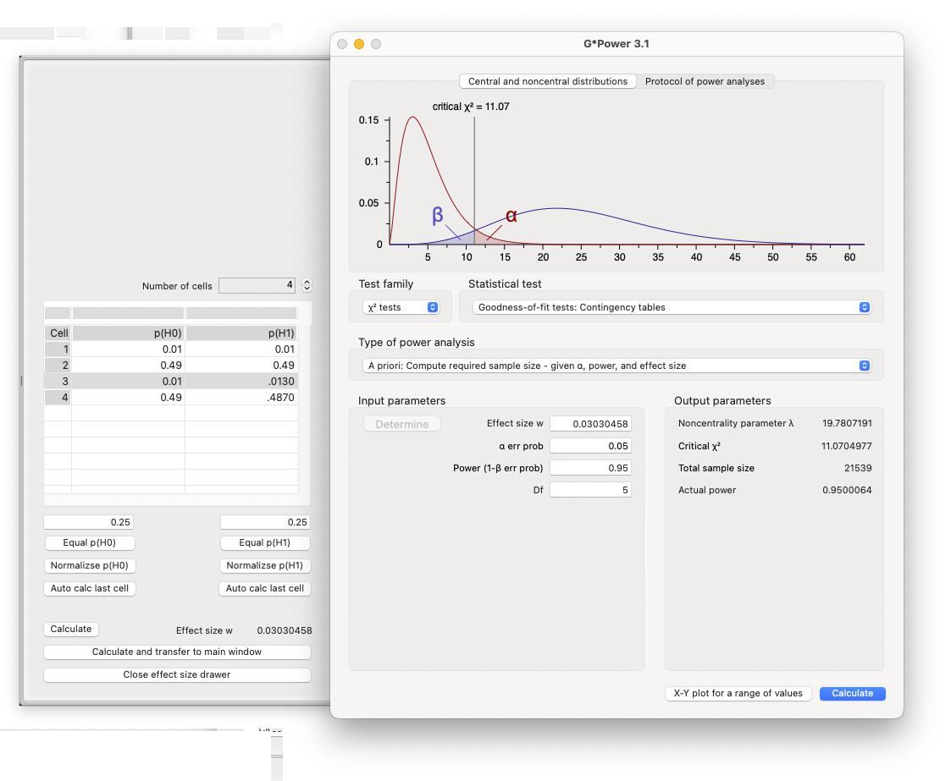
How long will it take (Sample Size)?

Slide 12
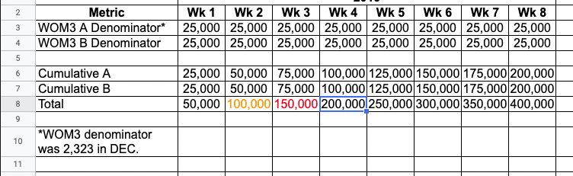
How long will it take (Duration)?

Slide 13
How can we ever be sure that the version with the best performance is not having more clicks due to just chance?
Why is the method (A/B Testing) valid? / Validity
Which conditions do need to be fulfilled in order for the method to work properly?
You have to make sure your experiment is offering the choice without bias (randomization of users and design of independent variants)
large enough sample size
test for statistical significance
incrementality
baseline data / version (a stable system, the current version → and the current conversion rate)

Slide 14
How can we ever be sure that the version with the best performance is not having more clicks due to just chance? - 2
We need enough data (users) > xx
Trying both options at the same time _ so that all other influences will be valid for both options
Take good care of how users are randomized on one of the variants
Idea / Concept of “chance” of everyday language
Idea / Concept of “chance” / randomness of statistical inference

